Slide 1
Bduiling Mindset
Mohammad Abul Kashem
DG (Secretary)
NAPD

Slide 2

A way of thinking
Usual attitude
Collection of thoughts
Firm beliefs
Mental condition
Habit
Outlook

Slide 3
Mindset
A mindset refers to whether you believe qualities , such as intelligence and talent are fixed or changeable traits.
There are two different types of mindset :
Fixed mindset : People with fixed mindset believe that these qualities are inborn, fixed and unchangeable. They cannot do anything to tackle the problem as they think that which is out of their reach and abilities.
Growth mindset: Those with a growth mindset believe that these abilities can be developed and strengthened by way of commitment and hard work. When faced with some difficulties, they believe that they can learn and develop skills to solve problems.

Slide 4
Fixed Mindset : Children who are taught that they should look smart instead of loving learning tend to develop a fixed mindset. They become more concerned with how they are being judged and fear that they might not live up to expectations.

Slide 5
Mindset
Growth Mindset:
Kids who are taught to explore, embrace new experiences, and enjoy challenges are more likely to develop a growth mindset.
Rather than seeing mistakes as setbacks, they are willing to try new things and make errors all in the name of learning and achieving their potential.

Slide 6
Identify Fixed & Growth Mindset
1. People have a certain amount of intelligence, and there
isn't any way to change it.
2. No matter who you are, there isn't much you can do to
improve your basic abilities and personality.
3. People are capable of changing who they are.
4. You can learn new things and improve your intelligence.
5. People either have particular talents, or they don't. You
can't just acquire talent for things like music, writing, art,
or athletics.
6. Studying, working hard, and practicing new skills are all
ways to develop new talents and abilities.
Note : 1, 2, 5=Fixed mindset.
3, 4, 6 = Growth mindset.

Slide 7
Difference between Fixed & Grtowth Mindset
Fixed Mindset | Growth mindset
1.Challenges: Avoid challenges. | 1. Challenges: Embrace challenges
2. Obstacles : Give up easily. | 2. Obstacles: Persist in the face of setback.
3.Effort: See effort as fruitless or worse. | 3. Effort: See effort as the path to mastery.
4. Criticism : Ignore useful negative feedback | 4. Criticism : Learn from criticism.
5. Success of others: Feel threatened by the success of others. | 5. Success of others: Find lessons and inspiration in the success of others.
6. Result: Achieve less than their potential | 6. Result : They reach ever-higher level of achievement

Slide 8
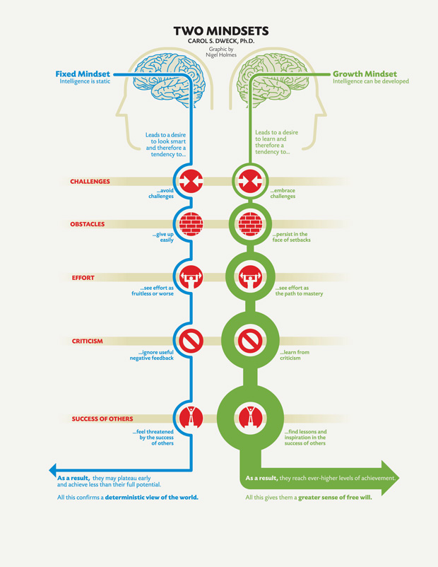

Slide 9
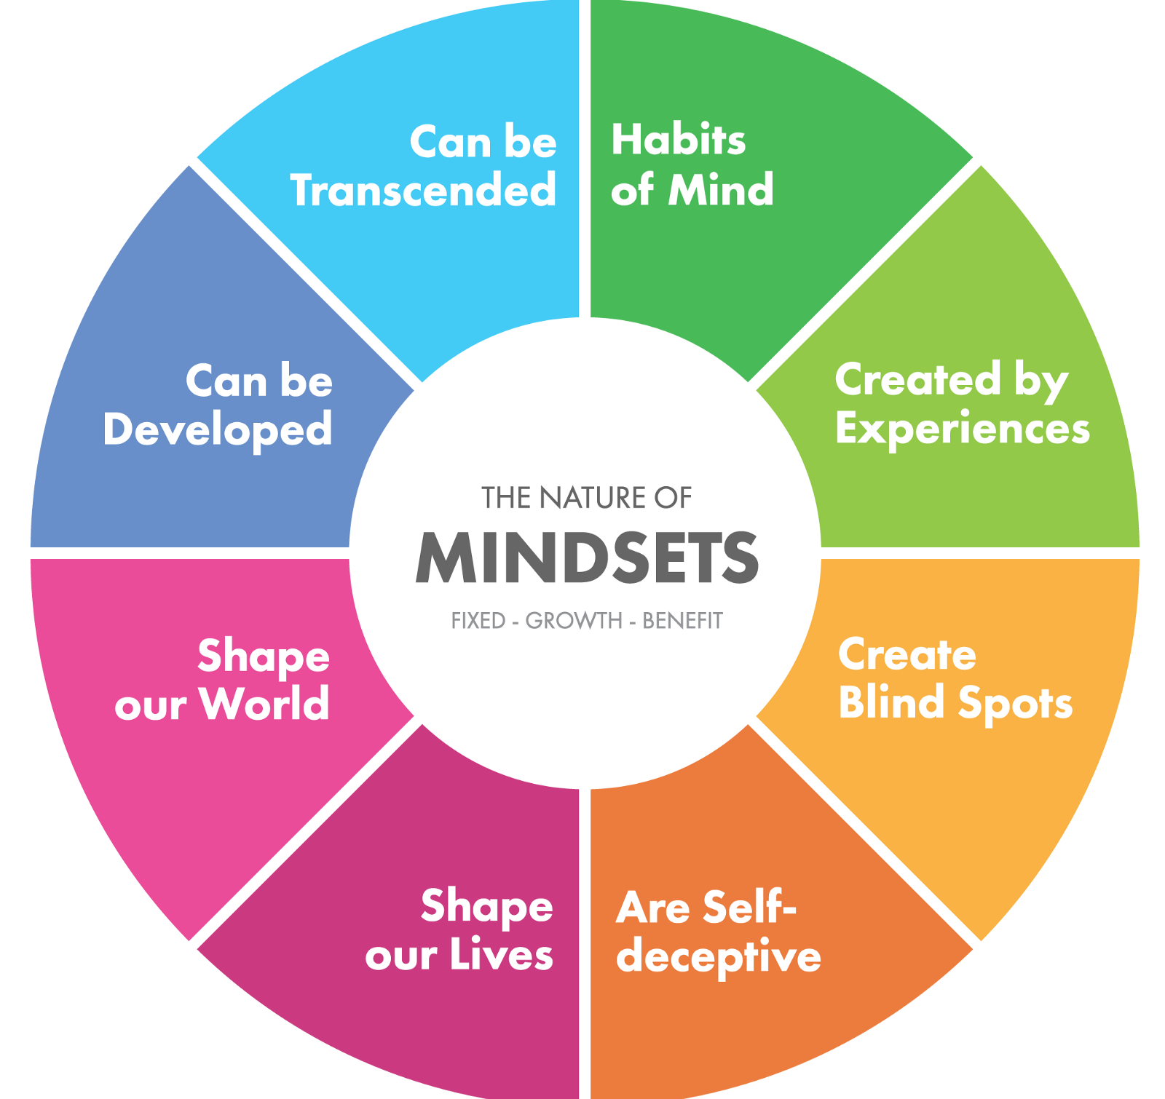
Benefits of growth Mindsets
Mindsets shape the lives we lead, the actions we take and the future possibilities of the world we live in.

Slide 10
The Elements For Changing Mindset
Commitment | Discipline
Honesty & Integrity | Accountability
Transparency | New Technology
Responsiveness | Professionalism
Team spirit & team building | Innovation

Slide 11

What’s that ?

Slide 12
What you & the people desire ?
Good behavior: Good behavior is a virtue. (Hadith)
Quick service delivery
Quick response
Cooperation
Punctuality
Modesty & polite behavior.
We should follow practice these good qualities.

Slide 13
Whom we appreciate?
A proactive person
Innovative attitude
Discipline life
Honesty & integrity
Skill & knowledge
Timely response
Accountability and transparency.
So, we should follow, practice and maintain these qualities through experiences learning process.

Slide 14
What we & the people hate & dislike?
Corruption
Indiscipline life
Indecent behavior
Un-punctual
Drugs & drug addiction
Arrogance
Cruelty
Hue & cry
Impatience
Barbarians
Lure, pride, envy
So, these bad habits should be abandoned through education and learning.

Slide 15
Causes of Negative Mindset
Some are hormonal controlled
.
Some habits are genetically inherited
Some are controlled by environmental factor
Some are induced by friends’ behavior
Some are the results of ignorance & barbariance

Slide 16
Mindset
Good behavior
No corruption
Stakeholder satisfaction
Development of body, mind & soul
Quick service delivery
A good man/woman
Knowledge & skill
Self control
Discipline life
Punctuality

Slide 17
Types of Behavior
Two types of behavior:
(1) Instinctive Behavior
(2) Learning Behavior
Most of our behavior is learning. Behavior can be changed.

Slide 18
Why mindset change necessary
To know thyself
To remove weakness
To achieve honor and dignity
For better service delivery
To achieve own dreams & goals
To remove bad habits

Slide 19
Why mindset change necessary
To develop humanity
For innovation
To cope with the new environment
Struggle for existence & survival of the fittest
To cope with the society
To cope with the state culture
To enjoy one’s life

Slide 20

Symbol of spring !

Slide 21
Tools to change mindset
Continuous motivation
Cogent atmosphere
Rewards and incentives
Punishment
Love & affection
Good dreams
Good friends
Strict rules & regulation

Slide 22
Tools to change mindset
System change
Life style
Quality education & knowledge
Training
Healthy environment
Customs & values
Education for Humanity
Innovation & new technology

Slide 23
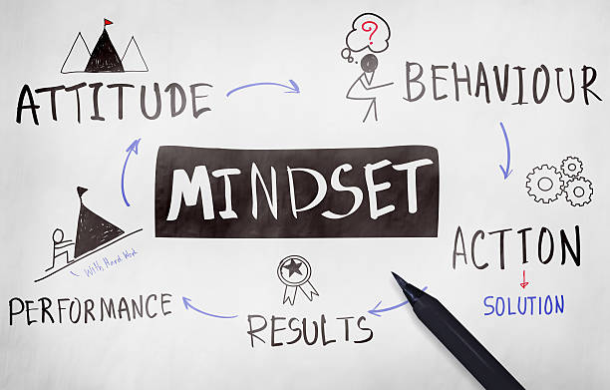
Mindset and Attitudes

Slide 24

Positive Attitude
Positive attitude brings favorable results.
It creates willingness to do new things
It is an attitude that helps you see the good in people.
A positive attitude is a mindset that helps you see and recognize opportunities.
Positive attitude means positive thinking
It is optimism and maintaining a positive mindset

Slide 25
Necessity of Training
For personal development through change in
Attitude
Skill
Knowledge
Overall Changing of Mindset.
Results : Achievement of the highest level.
Who doesn’t want it ?

Slide 26
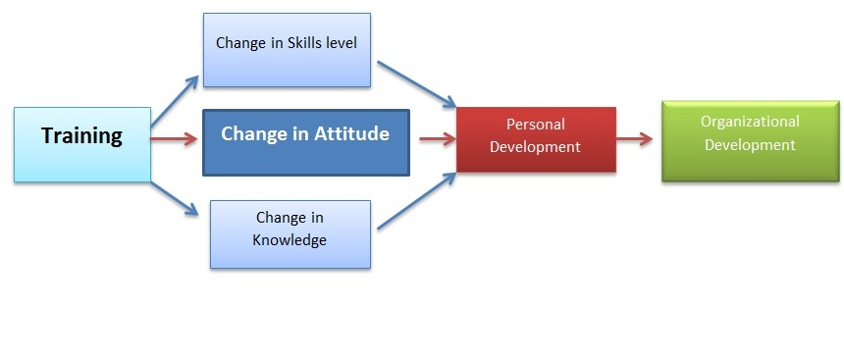
The Flowchart: Training and Development

Slide 27
Apparently comparative mindset what we see outwardly
Developed countries | Developing countries
Very positive in thinking | Very negative in thinking
No talk in train, bus, planes | Talk everywhere
Not emotional | Emotional
Don’t deposit money for future | Deposit money for the future
Not cheater, liar, dishonest. Don’t adulterate food | Cheater, liar, dishonest, adulterate food
Tax payee | Don’t pay tax
Keep word, don’t tell ill of others | Don’t keep word, tell ill of others
Innovative | Non-Innovative
Not-arrogant, polite | Arrogant , impolite.
Polished, gentle | Not polished, rude
Educated , patience, discipline | Illiterate , impatience, indiscipline
Inventors | Users

Slide 28
Impact of Negative Mindset
Govt. lose power
Bar to development
Deprive of legal rights
No work in office
People lose confidence to the govt.
Society or group get offended
Target or goal not achieved
Manifesto can’t be implemented
Hamper service delivery

Slide 29
Develop success-oriented Mindset
1. Acknowledge and embrace imperfection in self and others. Our perfections make us unique.
2. Face your challenges bravely.
3. Pay attention to your words and thoughts. Replace negative thoughts.
4. Stop seeking approval from others. Cultivate self-acceptance and self- approval. Learn to trust yourself.
5. Take a step deeper into authenticity. Becoming truly authentic is a process that takes time and a lot of inner work.
6. Cultivate a sense of purpose. Does your life feel like it is purpose driven ?
7. Define ‘genius. Work to improve your weakness.
8. Turn criticism around until you finds its gift. The purpose of criticism is to make thing better.

Slide 30
For Success-Oriented Mindset
9. Value the process over the end journey. Remember, it’s the journey that matters, not the destination.
10. Learn from the mistakes of others.
11. “Not yet” is OK. When struggling with a task, remind yourself that you haven’t mastered it “yet”
12. Take risks in the company of others. Try not to take yourself too seriously. Be willing to make mistakes in front of others.
13. Be realistic.
14. Speed is not important. Cultivate resilience along the way.
15. Own your attitude.

Slide 31

Don’t be pessimistic & demoralized

Slide 32

Don’t lose your heart

Slide 33
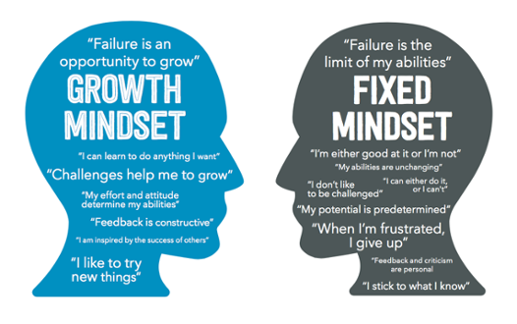

Slide 34
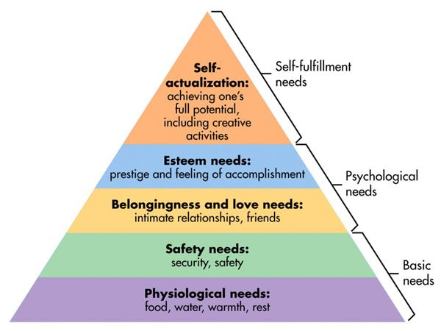

Slide 35


Slide 36


Slide 37
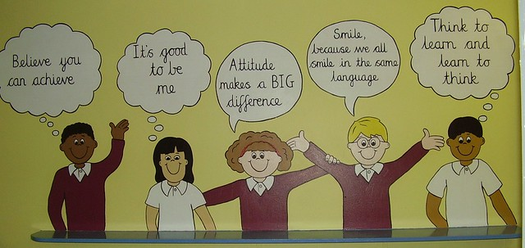

Slide 38
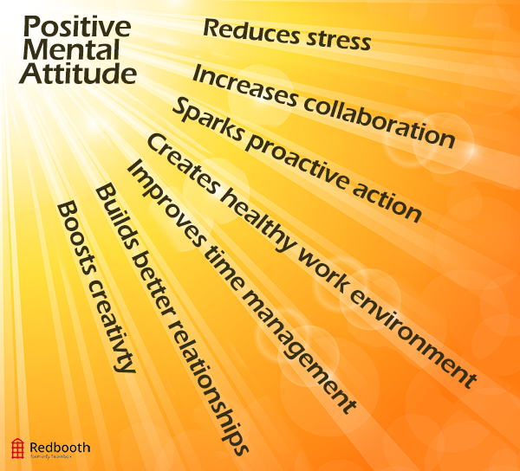

Slide 39


Slide 40


Slide 41
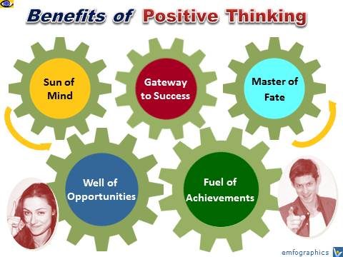

Slide 42
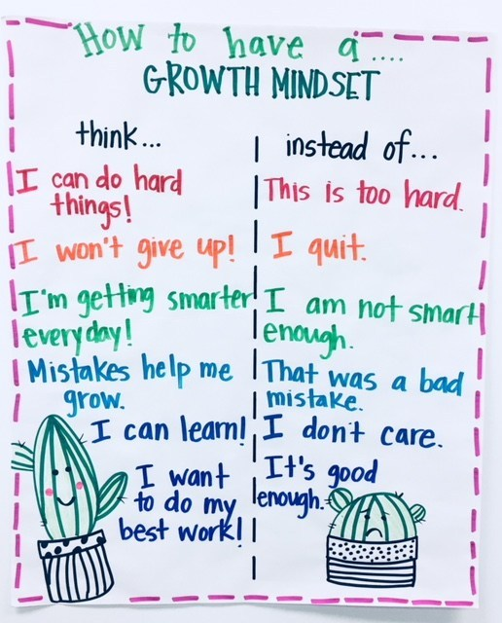

Slide 43
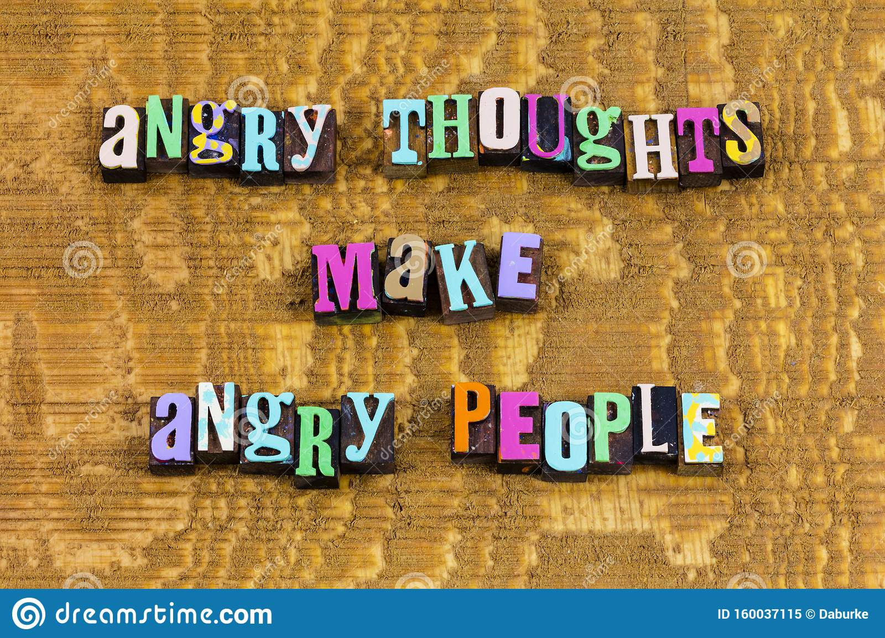

Slide 44


Slide 45
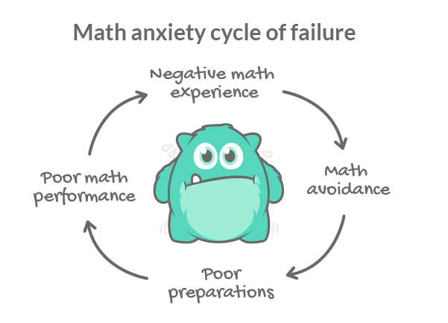

Slide 46
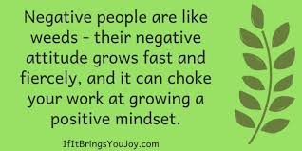

Slide 47


Slide 48
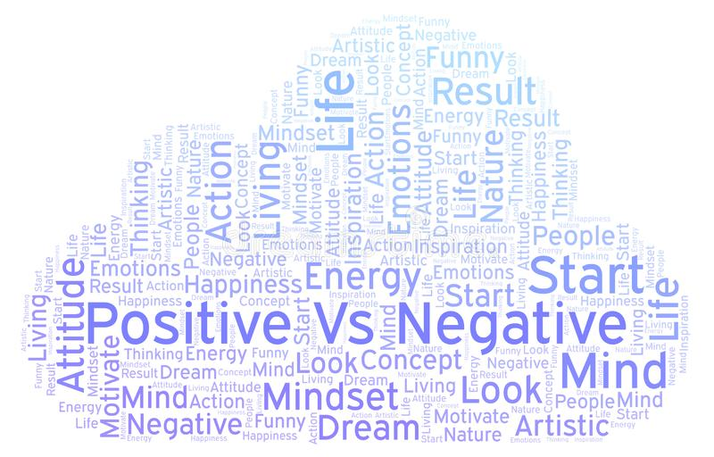

Slide 49


Slide 50
Conclusion
Do you want to enjoy yourself ?
Do you desire to be honored and dignity ?
So, change your mindset.
Come out from your firm belief on anything else if it’s not supported by science and logic.
Be realistic, rather than emotional.
Two things are not in human hands ; Death and Destiny.
Everybody should take the taste of death.
Walqadre Hairihee Washarrehe. I have believed in my destiny and what would be happened.
We don’t know when we will die. But, even knowing the end result, we continue to work.
Even our destiny is zero, but we continue to work.

Slide 51

Thank You Very Much

